Slide 1
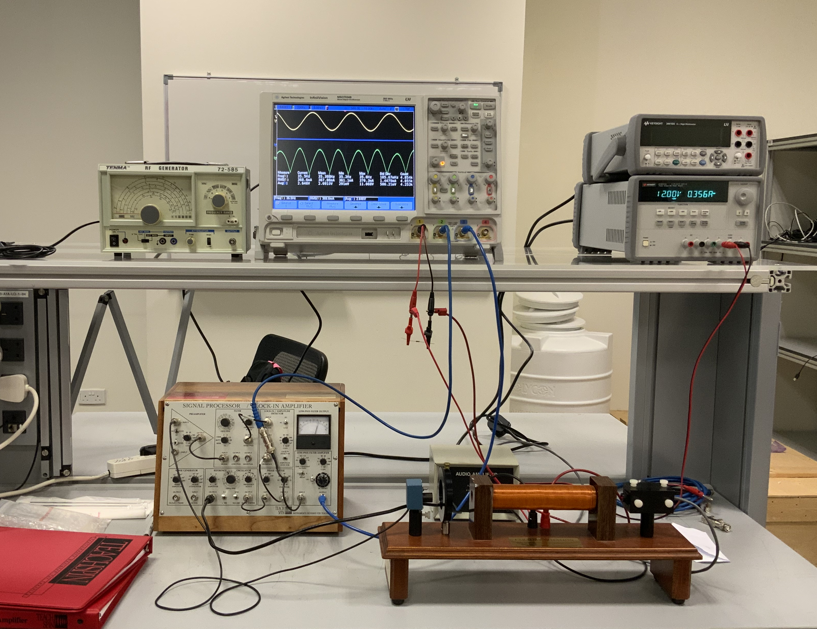
Oscilloscope
Power Supply
Audio Amplifier
Lock in Amplifier
Polarizer
Laser
Photodiode
Inductor

Slide 2
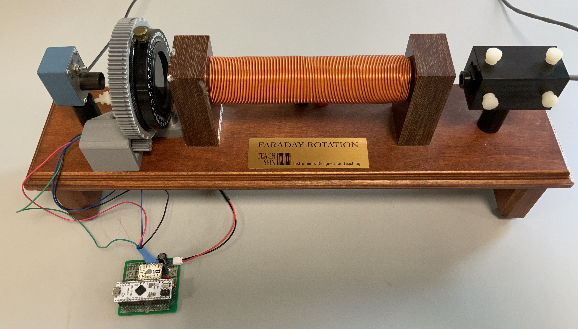
Photodiode
Inductor
LASER
Polarizer and Motor
Motor Control Board

